Slide 1


PMIT-6204: Cryptography & Steganography
for
3rd Semester of PMIT Program
Lecture File: 08
Advanced Encryption Standard (AES)
Prepared by:
Professor K M Akkas Ali
akkas_khan@yahoo.com, akkas@juniv.edu
Institute of Information Technology (IIT)
Jahangirnagar University, Dhaka-1342

Slide 2
Lecture File-08:
Advanced Encryption Standard (AES)
Topics to be Discussed
What Is AES?
To review a short history of AES
The features of AES that make it a unique algorithm
Basic structure of AES of each round at the encryption site
How does AES Work?
Types of transformations used by AES
Key expansion process in AES-128
Applications of AES
Difference's between AES & DES
To discuss different implementations

Slide 3
What is AES (Advanced Encryption Standard):
The AES algorithm (also known as the Rijndael algorithm) is a symmetric block cipher algorithm that takes a block size of 128 bits and converts them into ciphertext using keys of 128, 192, and 256 bits.
11.3
Notes:
3

Slide 4
History of AES (Advanced Encryption Standard):
Until 2000, DES (Data Encryption Standard) had been used as a standard method of encryption, but with increase in speed in computers and having shorter key length, it is no more considered secure as a cryptanalyst can break the code by exhaustively searching for all the keys using a fast computer.
From 2001, DES has been replaced by a new standard known as the Advanced Encryption Standard (AES) which is published by the National Institute of Standards and Technology (NIST).
In 1997, NIST started looking for a replacement for DES, which would be called the Advanced Encryption Standard or AES.
The NIST specifications required a block size of 128 bits and three different key sizes of 128, 192, and 256 bits.
The specifications also required that AES be an open algorithm, available to the public worldwide. The announcement was made internationally to solicit responses from all over the world.
After the First AES Candidate Conference, NIST announced that 15 out of 21 received algorithms had met the requirements and been selected as the first candidates (August 1998).
Algorithms were submitted from a number of countries; the variety of these proposals demonstrated the openness of the process and worldwide participation.
11.4
Notes:
4

Slide 5
History of AES (Advanced Encryption Standard):
After the Second AES Candidate Conference, which was held in Rome, NIST announced that 5 out of 15 candidates—MARS, RC6, Rijndael, Serpent, and Twofish— were selected as the finalists (August 1999).
After the Third AES Candidate Conference, NIST announced that Rijndael designed by Belgian researchers Joan Daemen and Vincent Rijment, was selected as Advanced Encryption Standard (October 2000).
In February 2001, NIST announced that a draft of the Federal Information Processing Standard (FIPS) was available for public review and comment.
Finally, AES was published as FIPS 197 in the Federal Register in December 2001.
11.5
Notes:
5

Slide 6
Features of AES:
The features that make AES a unique algorithm are:
It uses Substitution and Permutations, also called SP Networks.
A single key is expanded to be used in multiple rounds.
AES performs on byte data, instead of bit data.
No. of rounds is dependent on key length.
Three different key length:
128-bit Key Length uses 10 rounds
192-bit Key Length uses 12 rounds
256-bit Key Length uses 14 rounds
11.6
Notes:
6

Slide 7
Criteria Defined by NIST for AES:
The criteria defined by NIST for selecting AES fall into three areas:
Security:
The main emphasis was on security. Because NIST explicitly demanded a 128-bit key, this criterion focused on resistance to cryptanalysis attacks other than brute-force attack.
Cost:
The second criterion was cost, which covers the computational efficiency and storage requirement for different implementations such as hardware, software, or smart cards.
Implementation:
The third criterion was implementation. This criterion included the requirement that the algorithm must have flexibility (be implementable on any platform) and simplicity. It also required that AES be an open algorithm, available to the public worldwide.
At the end, Rijndael was judged the best at meeting the combination of these criteria.
11.7
Notes:
7

Slide 8
Parameters for Three Versions of AES:
AES is a non-Feistel cipher (i.e., it uses only invertible components).
In AES, there is no need to divide the plaintext into two halves as we saw in the Feistel ciphers like DES.
AES is a block cipher that encrypts and decrypts data as a block of 128 bits.
It uses 10, 12, or 14 rounds.
Three different key sizes of 128, 192, and 256 bits can be used which depends on the number of rounds.
AES has defined three versions with 10, 12, and 14 rounds. The versions are referred as AES-128, AES-192, and AES-256.
Each version uses a different cipher key size (128, 192, or 256 bits), but the round keys (which are created by the key-expansion algorithm) are always 128 bits which is the same size as the plaintext or ciphertext block.
11.8
Notes:
8

Slide 9
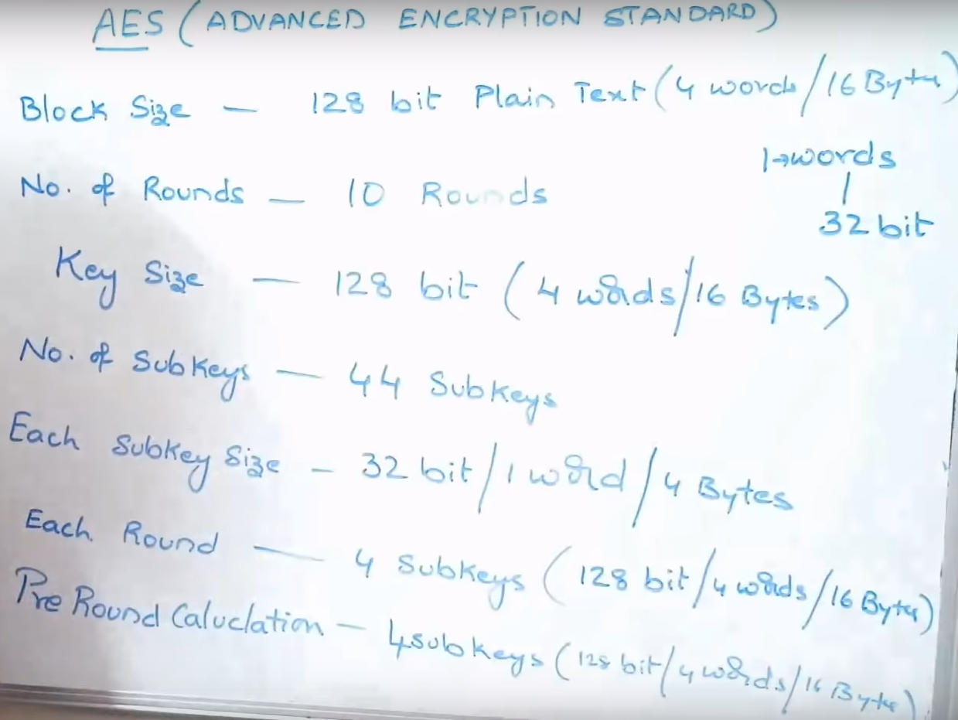
Common Parameters about AES:
11.9
Notes:
9

Slide 10
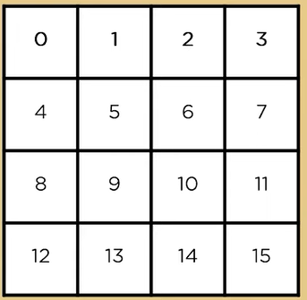
Manner of Storing Input Data: Block-to-State Conversion
Let us know how data is being stored during the process of AES encryption.
The plaintext block to be encrypted is just a sequence of 128 bits.
AES works with byte quantities. So at first, we convert the 128 bits into 16 bytes.
These 16 bytes of plaintext data is arranged in a 4 x 4 matrix format which is known as state array.
Each round takes the state array as input and gives corresponding output of 4 x 4 matrix.
At the start of the encryption, the 16 bytes of data, numbered are loaded into the array as shown in Table where each cell corresponds to one byte.
4 bytes (i.e., 32 bits) make one word, so each state array has 4 words.
11.10
Notes:
10

Slide 11
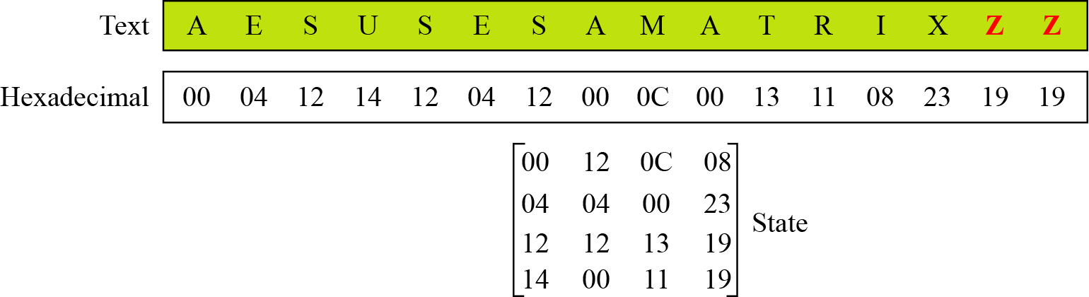
Manner of Storing Input Data: Block-to-State Conversion
Example:
Let us see how a 16-character block can be shown as a 4 x 4 matrix.
Assume that the text block is “AES uses a matrix”.
We add two bogus characters at the end to get “AESUSESAMATRIXZZ”.
Now we replace each character with a decimal integer between 00 and 25.
We then show each byte as an integer with two hexadecimal digits. For example, the character “S” is first changed to 18 and then written as 12₁₆ in hexadecimal. The state matrix is then filled up, column by column, as shown in the figure below.
11.11
Figure: Changing plaintext to state
Notes:
11

Slide 12
Steps in AES Encryption Process
The AES encryption process uses a set of specially derived keys called round keys. Along with other operations, these round keys are applied on an array of data that holds exactly one block of data that is to be encrypted.
The steps in the encryption of AES 128-bit block are listed below:
Derive the set of round keys from the cipher key.
Initialize the state array with the block data (plaintext).
Add the initial round key to the starting state array.
Perform nine rounds of state manipulation.
Perform the tenth and final round of state manipulation.
Note:
The reason that the rounds have been listed as "nine followed by a final tenth round" is because the tenth round involves a slightly different manipulation from the others.
11.12
Notes:
12

Slide 13
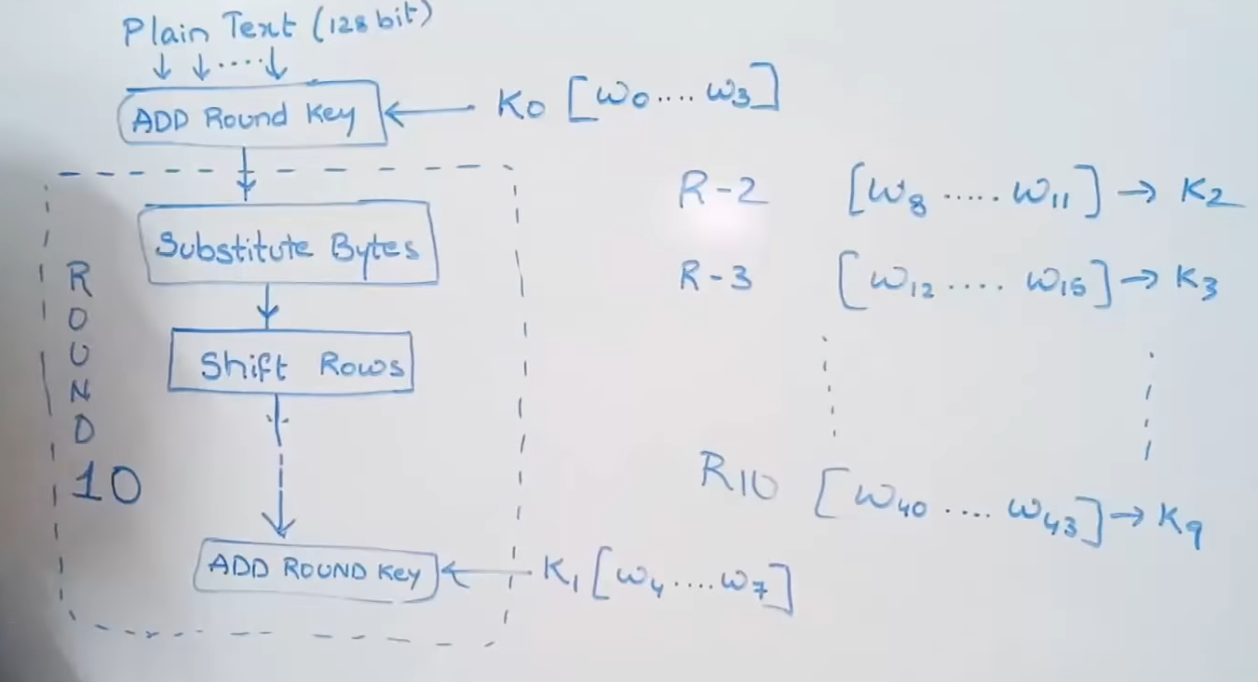
Simplified Block Diagram of AES
Notes:
13

Slide 14
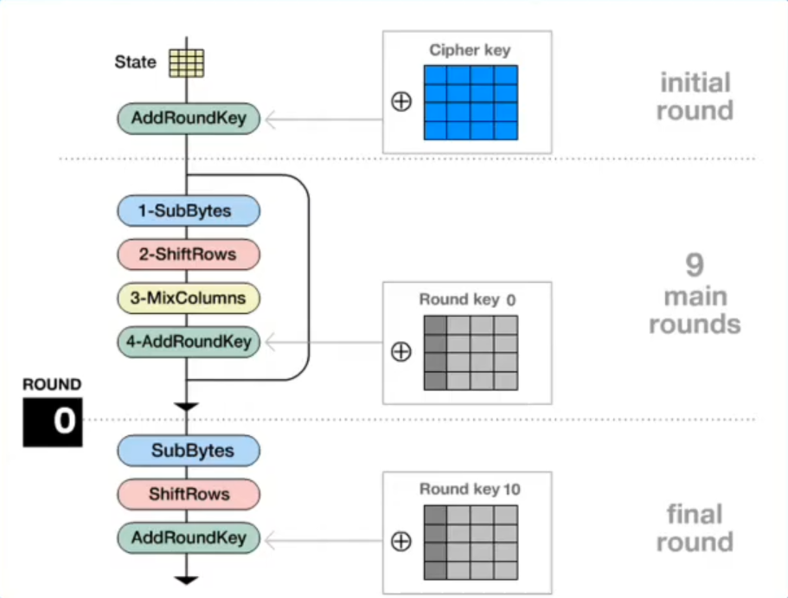
Simplified Block Diagram of AES
Four operations are required in each round:
11.14
Notes:
14

Slide 15
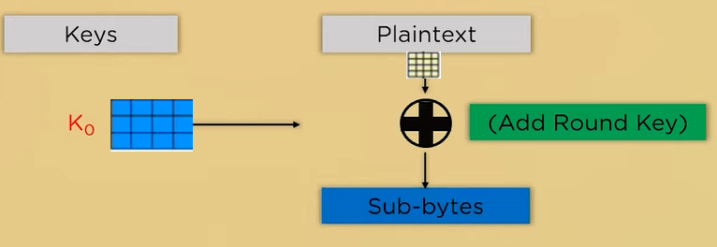
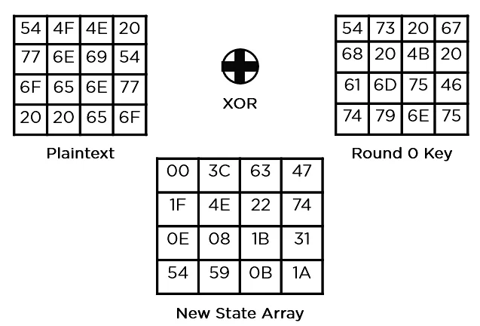
Pre-round Operations in AES
In the very beginning, the plaintext state array is Exor-ed with the initial round key K₀.
The output is passed to a byte substitution process.
Example:
54 = 01010100
54 = 01010100
00 = 00000000
77 = 01110111
68 = 01101000
1F = 00011111
11.15
Notes:
15

Slide 16
Round Operations in AES
Following four operations are required to perform in round-1 to round-9:
SubBytes
ShiftRows
MixColumns
XorRoundKey
In the final round (10th round), following three operations are required to perform
SubBytes
ShiftRows
XorRoundKey
11.16
Notes:
16

Slide 17
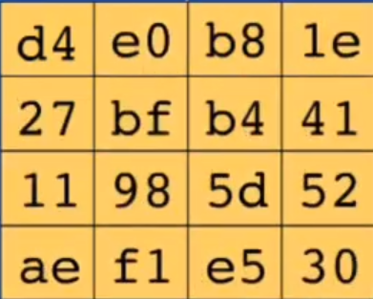
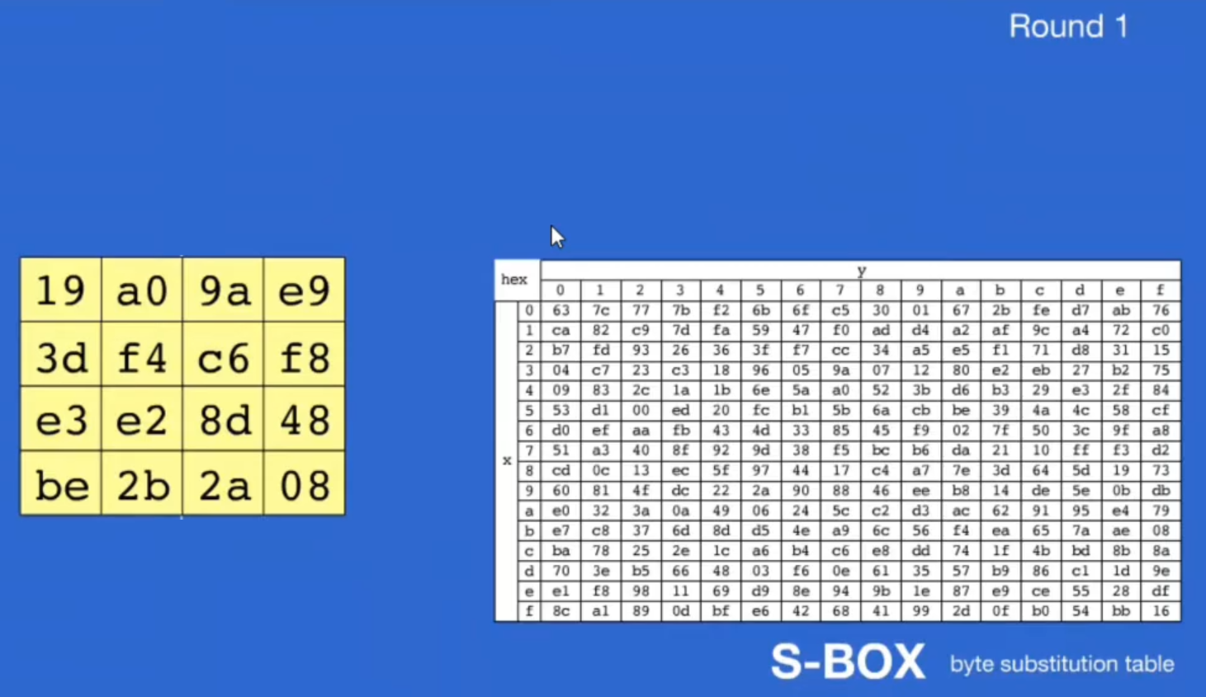
1. SubBytes Operations
State Matrix after SubBytes Operation
State Matrix before SubBytes Operation
11.17
Notes:
17

Slide 18
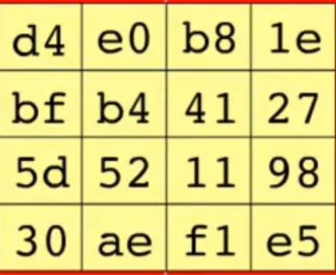
2. ShiftRows Operation
Row 0: Rotate each byte from right to left over 0 byte
Row 1: Rotate each byte from right to left over 1 byte
Row 2: Rotate each byte from right to left over 2 byte
Row 3: Rotate each byte from right to left over 3 byte
State Matrix before ShiftRows Operation
11.18
State Matrix after ShiftRows Operation
Notes:
18

Slide 19
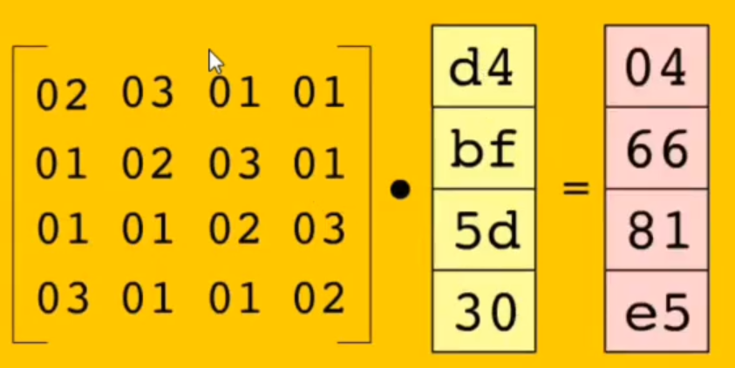
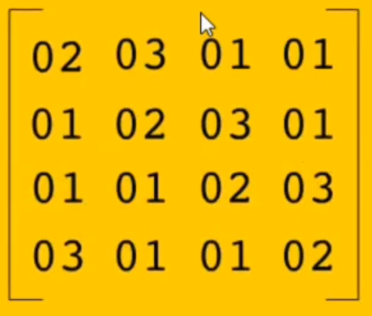
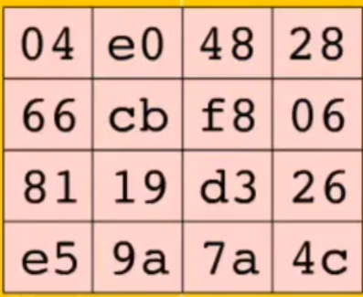
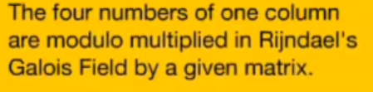
3. MixColumn Operation:
State Matrix before MixColumn Operation
11.19
State Matrix after MixColumn Operation
Notes:
19

Slide 20
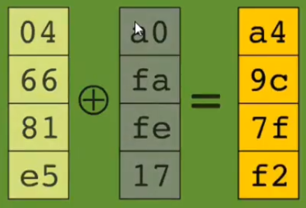
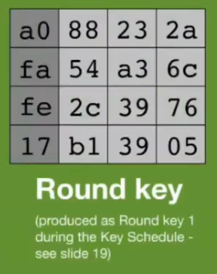
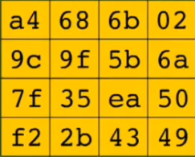
4. AddRoundKey Operation:
State Matrix before AddRoundKey Operation
11.20
State Matrix after AddRoundKey Operation
Notes:
20

Slide 21
AES Key Expansion
To create round key for each round, AES uses a key-expansion process.
The cipher key is expanded to n + 1 rounds, with n being the number of rounds.
The first round key is used for pre-round transformation (AddRoundKey); the remaining round keys are used for the last transformation (AddRoundKey) at the end of each round.
4 words in each key.
Each key is used for a single round. The first key is used as initial round key before any round begins.
11.21
Notes:
21

Slide 22
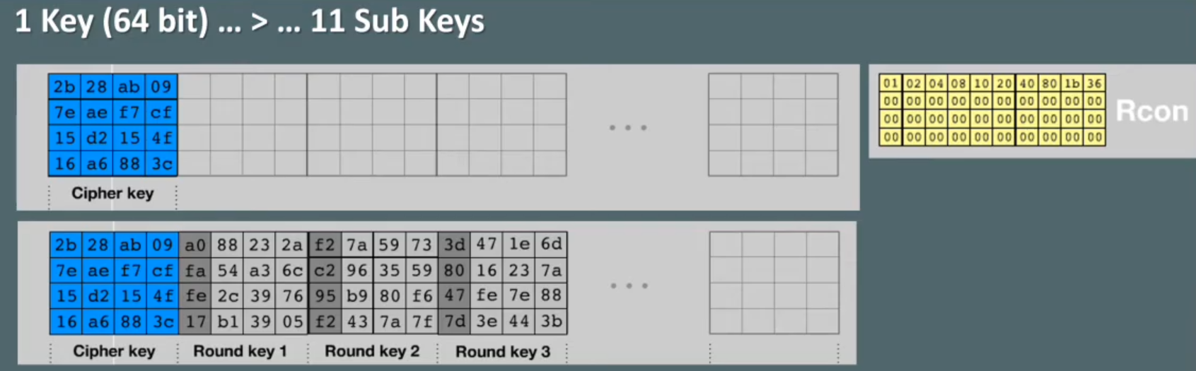
Key Schedule Algorithm in AES-128:
Rcon = A Constant Table
11.22
Notes:
22

Slide 23
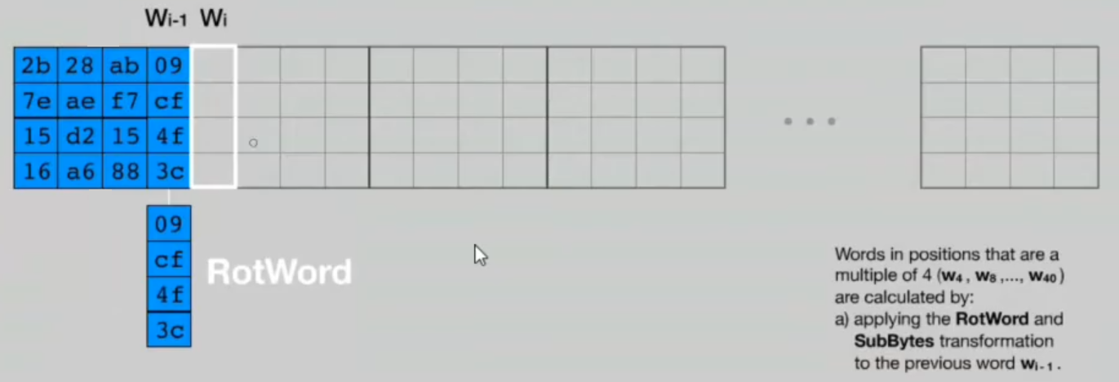
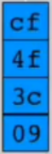
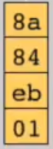
Key Schedule Algorithm in AES-128:
Substitute these values by the S-box
After rotation
11.23
After substitution
Notes:
23

Slide 24
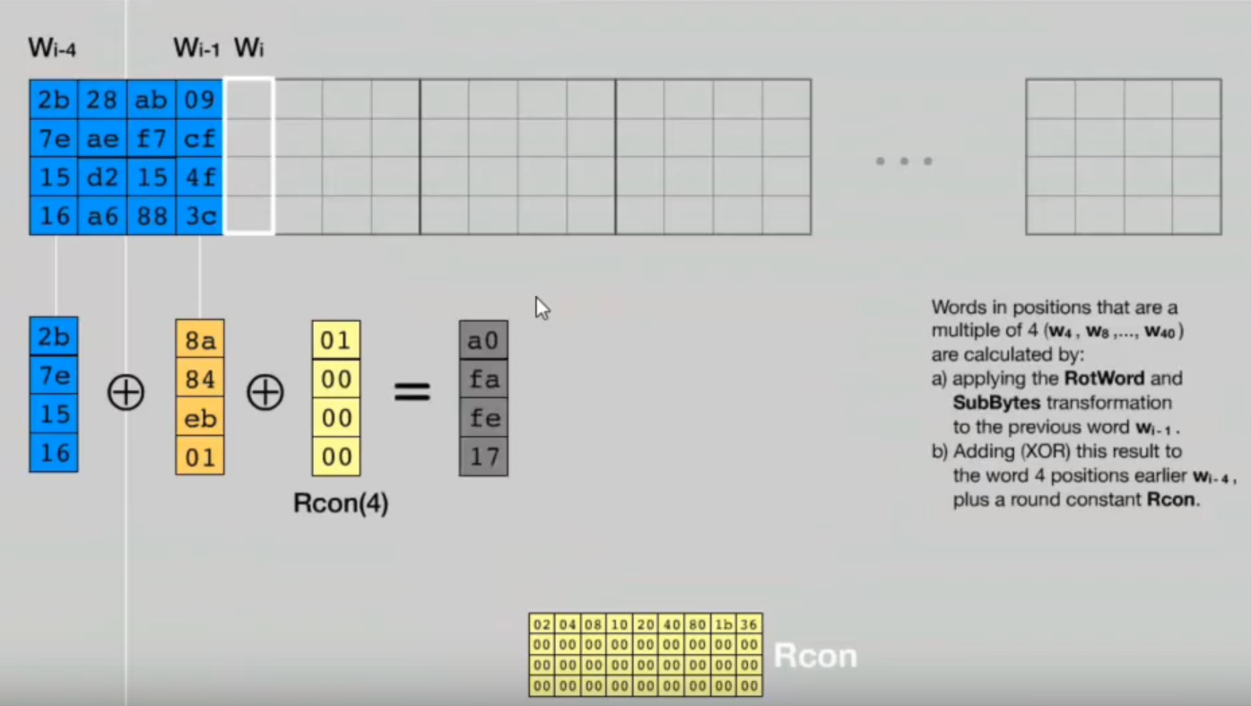
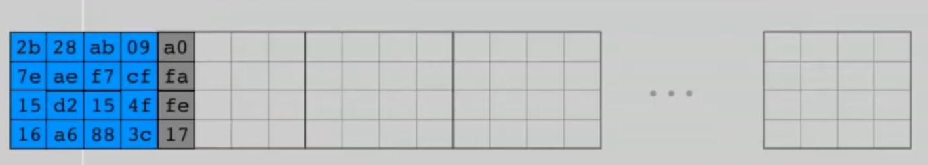
Key Schedule Algorithm in AES-128:
11.24
Notes:
24

Slide 25
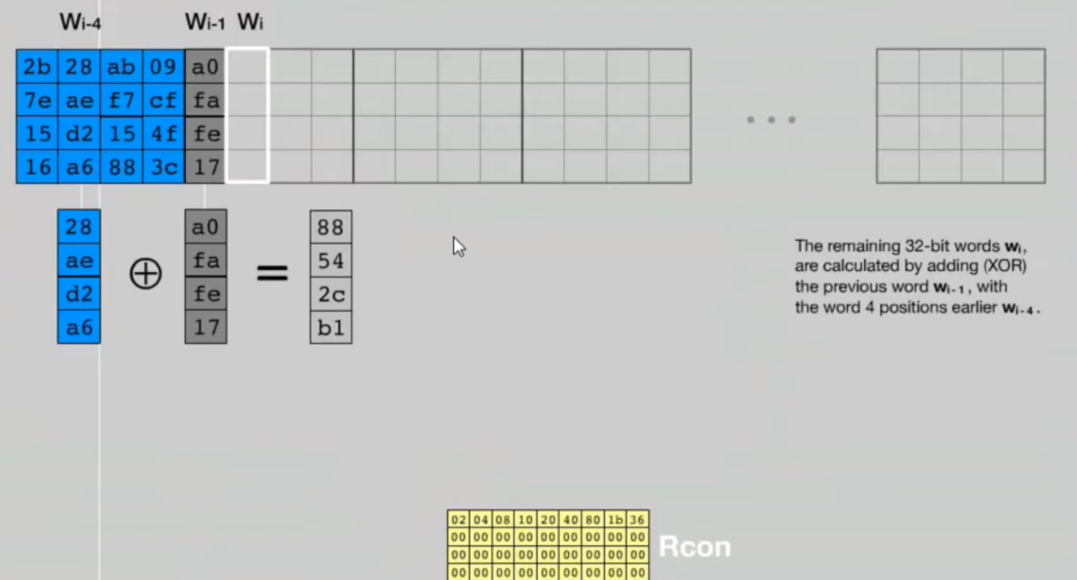
Key Schedule Algorithm in AES-128:
11.25
Notes:
25

Slide 26
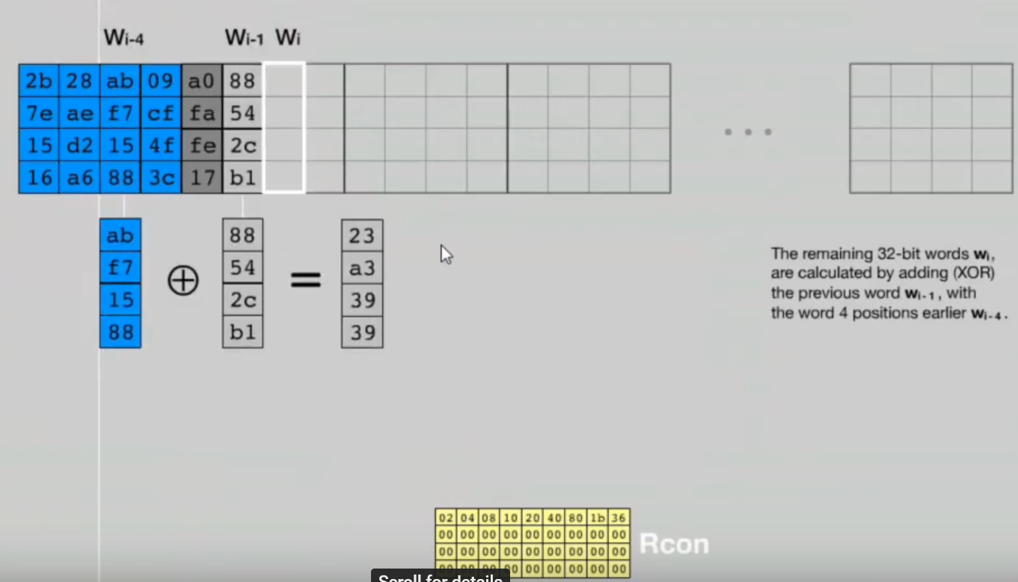
Key Schedule Algorithm in AES-128:
11.26
Notes:
26

Slide 27
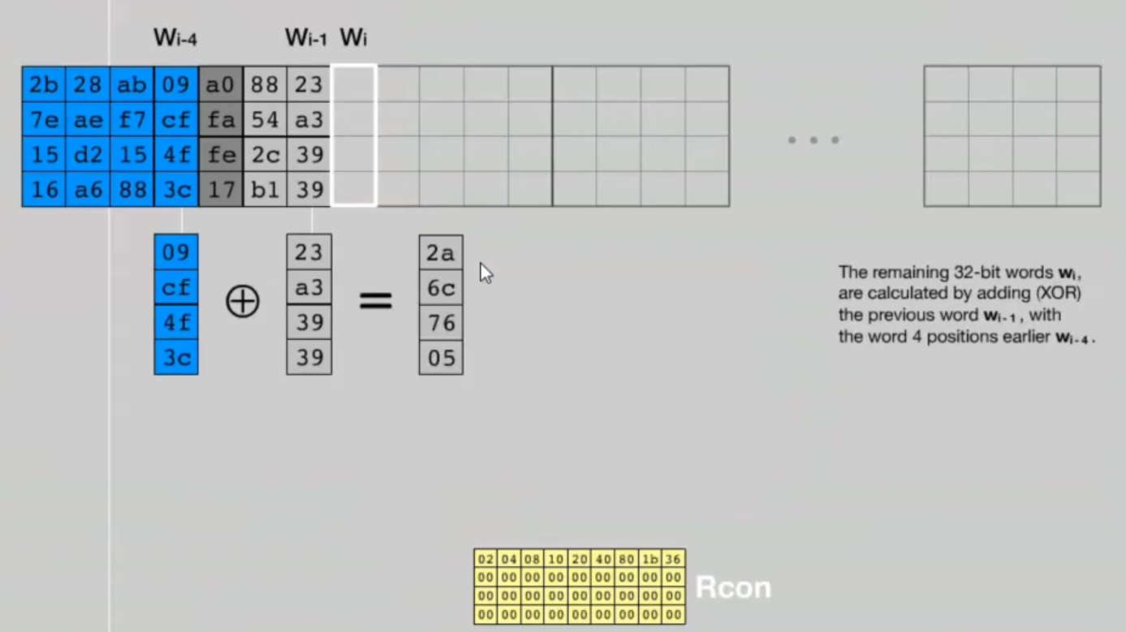
Key Schedule Algorithm in AES-128:
11.27
Notes:
27

Slide 28
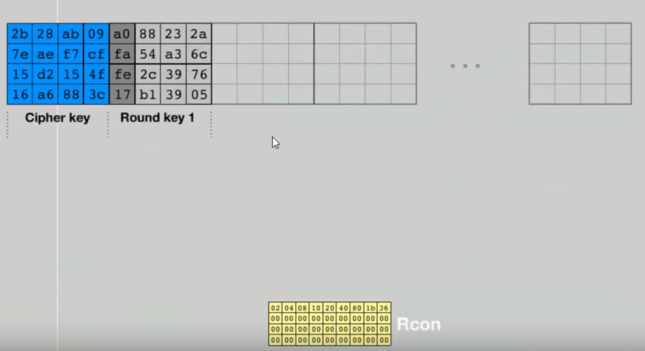
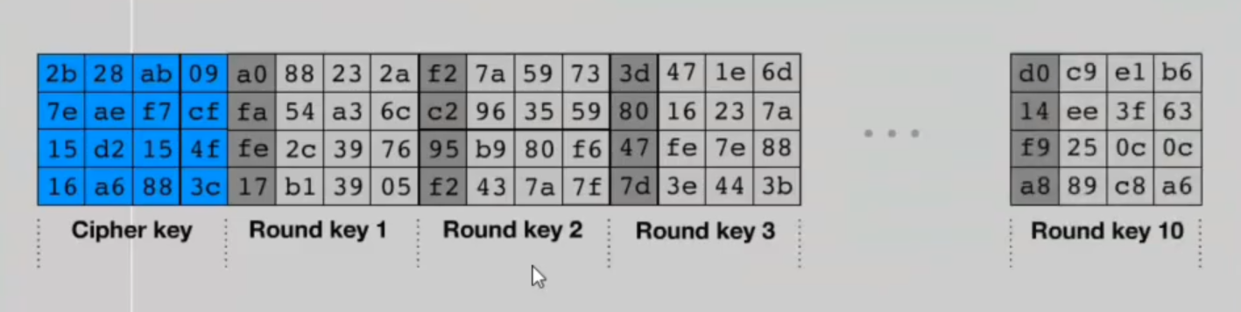
Key Schedule Algorithm in AES-128:
11.28
Notes:
28

Slide 29
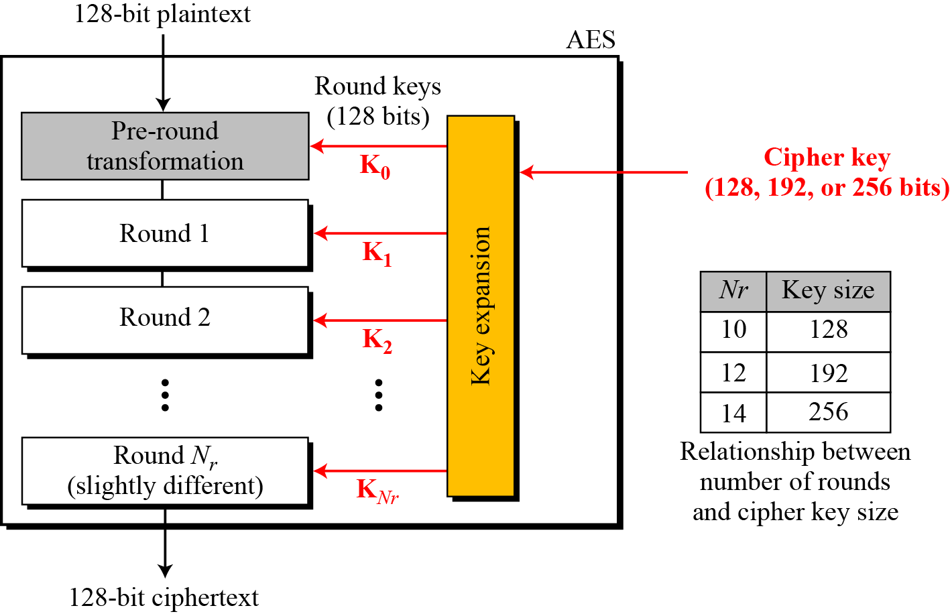
General Design of AES Encryption Cipher:
Figure below shows the general design for the encryption algorithm (called cipher). N_{r} defines the number of rounds. Figure also shows the relationship between the number of rounds and the key size.
The decryption algorithm (called inverse cipher) is similar, but the round keys are applied in the reverse order.
The number of round keys generated by the key-expansion algorithm is always one more than the number of rounds.
In other words, we have: Number of round keys = N_{r}+1
We refer to the round keys as K₀, K₁, K₂, . . . , K_{Nr}.
11.29
Figure: General design of AES encryption cipher
Notes:
29

Slide 30
Data Units in AES:
AES uses five units of measurement to refer to data:
Bit:
In AES, a bit is a binary digit with a value of 0 or 1 . We use a lowercase letter b to refer to a bit.
Byte:
A byte is a group of eight bits that can be treated as a single entity: a row matrix (1 x 8) of eight bits, or a column matrix (8 x 1) of eight bits.
When treated as a row matrix, the bits are inserted to the matrix from left to right; when treated as a column matrix, the bits are inserted into the matrix from top to bottom. We use a lowercase bold b letter to refer to a byte.
Word:
A word is a group of 32 bits (4 bytes) that can be treated as a single entity, a row matrix of four bytes, or a column matrix of four bytes.
When it is treated as a row matrix, the bytes are inserted into the matrix from left to right; when it is considered as a column matrix, the bytes are inserted into the matrix from top to bottom. We use the lowercase bold letter w to show a word.
Blocks:
AES encrypts and decrypts data as blocks. A block in AES is a group of 128 bits (4 words or 16 bytes). However, a block can be represented as a row matrix of 16 bytes.
11.30
Notes:
30

Slide 31
Data Units in AES:
State:
AES uses several rounds in which each round is made of several stages.
Data block is transformed from one stage to another.
At the beginning and end of the cipher, AES uses the term data block; before and after each stage, the data block is referred to as a state.
We use an uppercase bold letter S to refer to a state.
Although the states in different stages are normally called S, we occasionally use the letter T to refer to a temporary state.
States, like blocks, are made of 16 bytes, but normally are treated as matrices of 4 x 4 bytes. In this case, each element of a state is referred to as S_{r,c}, where r (0 to 3) defines the row and the c (0 to 3) defines the column.
11.31
Notes:
31

Slide 32
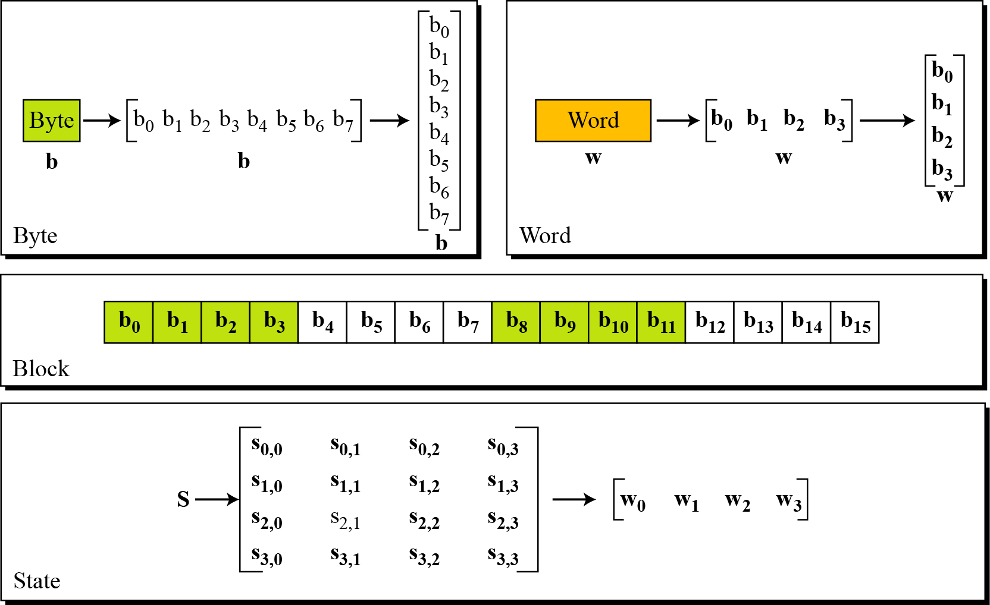
Data Units in AES:
Among the five units of measurement of data in AES, bit is the atomic unit and the remaining units are called non-atomic which are shown in the figure below.
11.32
Figure: Data units used in AES
Notes:
32

Slide 33
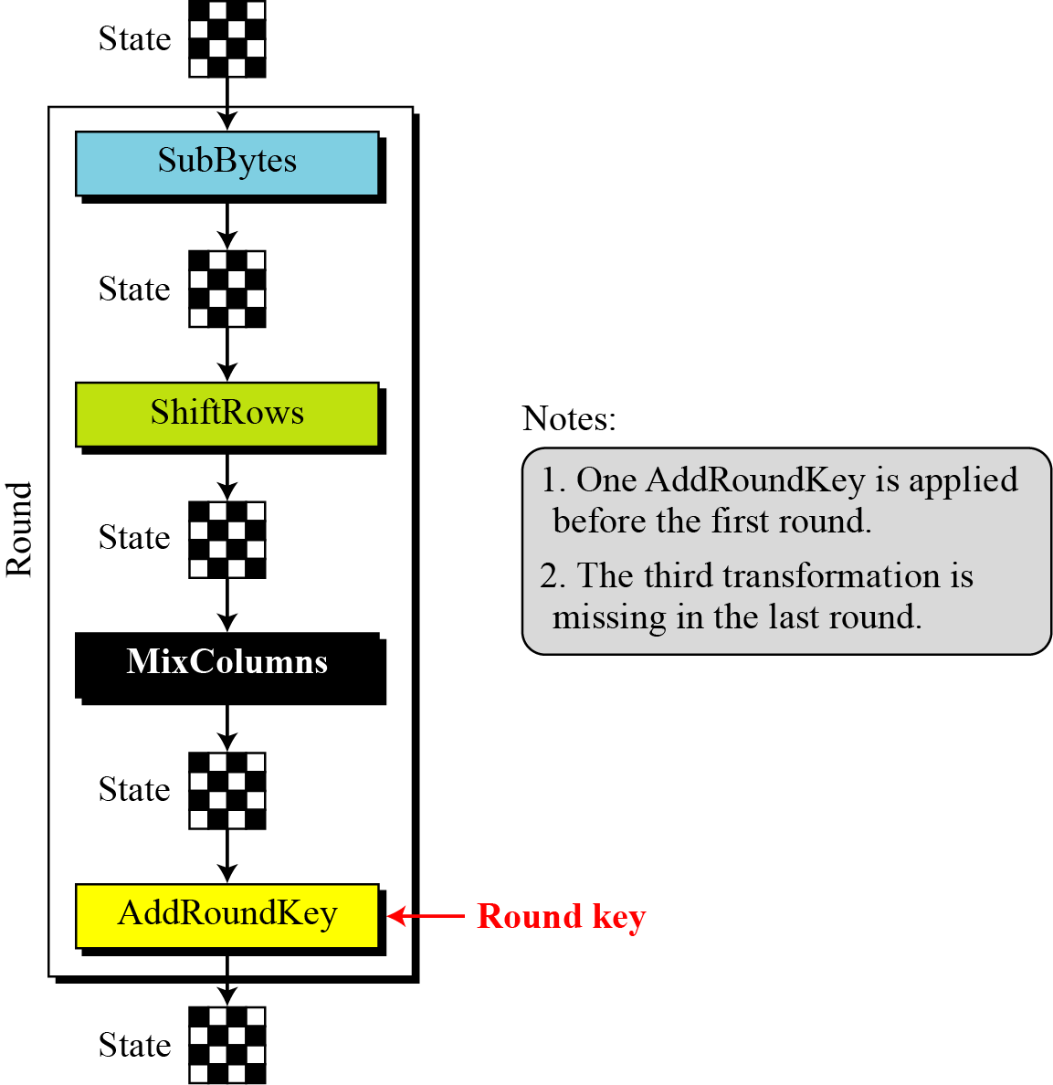
Structure of Each Round at the Encryption Site:
Figure below shows the structure of each round at the encryption side.
Each round, except the last, uses four transformations that are invertible:
SubByte
ShiftRows
MixColumns
AddRoundKey
The last round has only three transformations (except the third transformation).
Each transformation takes a state and creates another state to be used for the next transformation or the next round.
The pre-round section uses only one transformation (AddRoundKey); the last round uses only three transformations (MixColunms transformation is missing).
11.33
Figure: Structure of each round at the encryption site
Notes:
33

Slide 34
Transformations in AES:
To provide security, AES uses four types of transformations:
Substitution
Permutation
Mixing
Key-adding
Each round of AES, except the last, uses the four transformations. The last round uses only three of the four transformations (Mixing transformation is missing).
11.34
Notes:
34

Slide 35
Transformations in AES:
1) Substitution:
AES, like DES, uses substitution. However, the mechanism is different.
First, the substitution is done for each byte.
Second, only one table is used for transformation of every byte, which means that if two bytes are the same, the transformation is also the same.
Third, the transformation is defined by either a table lookup process or mathematical calculation in the GF(2⁸) field.
AES uses two invertible transformations, SubBytes and InvSubBytes, which are inverses of each other.
11.35
Notes:
35

Slide 36
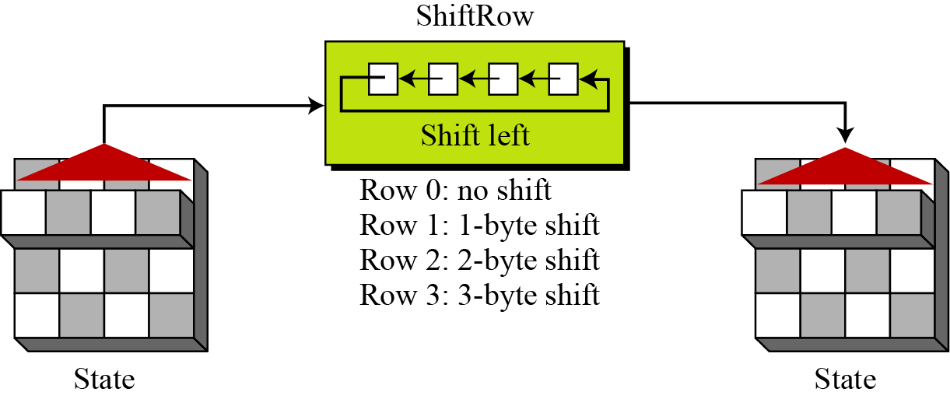
Transformations in AES:
2) Permutation:
The second transformation in a round is shifting, which permutes the bytes.
Unlike DES, in which permutation is done at the bit level, shifting transformation in AES is done at the byte level; the order of the bits in the byte is not changed.
In the encryption, the transformation is called ShiftRows. In the decryption, the transformation is called InvShiftRows. The ShiftRows and InvShiftRows transformations are inverses of each other.
In ShiftRows, the shifting is to the left. The number of shifts depends on the row number (0, 1 , 2, or 3) of the state matrix. This means the row 0 is not shifted at all and the last row is shifted three bytes. Figure below shows the shifting transformation.
11.36
Figure: ShiftRows transformation
Notes:
36

Slide 37
Transformations in AES:
3) Mixing:
The mixing transformation changes the contents of each byte by taking four bytes at a time and combining them to recreate four new bytes.
AES defines two mixing transformations, MixColumns and InvMixColumns, to be used in the encryption and decryption.
MixColumns multiplies the state matrix by a constant square matrix; the InvMixColumns does the same using the inverse constant matrix.
The MixColumns and InvMixColumns transformations are inverses of each other.
11.37
Notes:
37

Slide 38
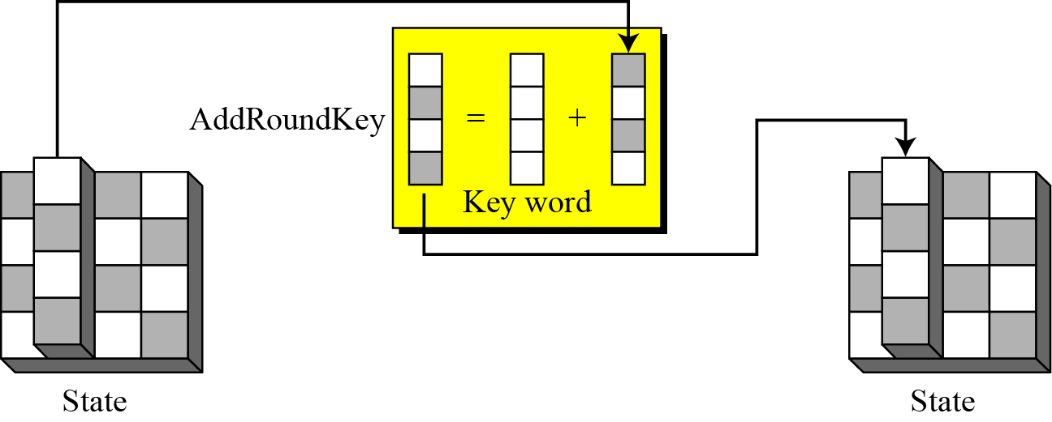
Transformations in AES:
4) Key-adding:
The transformation that performs whitening is called AddRoundKey.
The previous state is added (matrix addition) with the round matrix key to create the new state.
Addition of individual elements in the two matrices is done in GF(2⁸) which means that 8-bit words are XORed.
The AddRoundKey transformation is the inverse of itself.
11.38
Figure: AddRoundKey transformation
Notes:
38

Slide 39
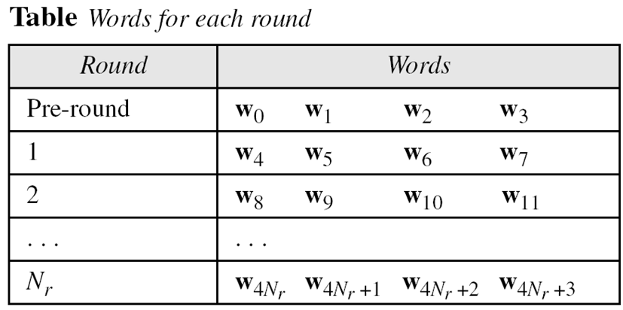
Key Expansion in AES:
To create round key for each round, AES uses a key-expansion process.
If the number of rounds is N_{r}, the key-expansion routine creates N_{r}+1 128-bit round keys from one single 128-bit cipher key.
The first round key is used for pre-round transformation (AddRoundKey); the remaining round keys are used for the last transformation (AddRoundKey) at the end of each round.
The key-expansion routine creates round keys word by word, where a word is an array of four bytes. The routine creates 4 x (N_{r} +1) words that are called: w₀, w₁, w₂, …..,w_{4(nr+1)-1}
In other words, in the AES-128 version (10 rounds), there are 44 words; in the AES 192 version (12 rounds), there are 52 words; and in the AES-256 version (with 14 rounds), there are 60 words.
Each round key is made of four words. Table shows the relationship between rounds and words.
11.39
Notes:
39

Slide 40
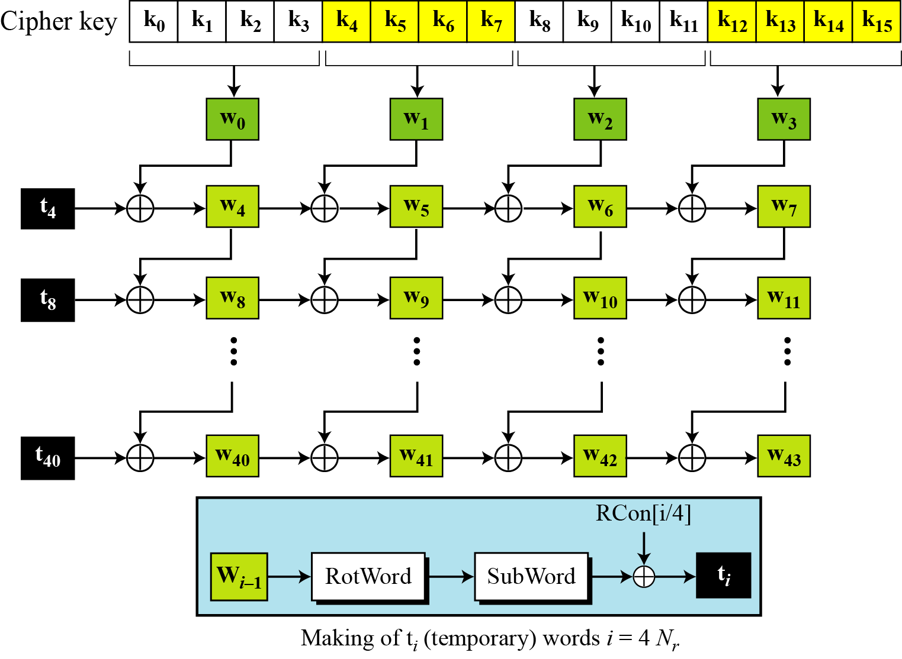
Key Expansion in AES-128:
Let us show the creation of words for the AES-128 version; the processes for the other two versions are the same with some slight changes.
Figure below shows how 44 words are made from the original key.
11.40
Figure: Key expansion in AES
Notes:
40

Slide 41
Key Expansion in AES-128:
The process is as follows:
The first four words (w₀, w₁, W₂, W₃) are made from the cipher key. The cipher key is thought of as an array of 16 bytes (k₀ to k₁₆). The first four bytes (k₀ to k₃) become w₀; the next four bytes (k₄ to k₇) become w₁ and so on.
The rest of the words (w_{i} for i = 4 to 43) are made as follows:
If (i mod 4) =! 0, w_{i} = w_{i-1} EXOR w_{i+4 .} Referring to the above figure, this means each word is made from the one at the left and the one at the top.
If (i mod 4) = 0, w_{i} = t EXOR w_{i-4}. Here t, a temporary word, is the result of applying two routines, SubWord and RotWord, on W_{i-1} and XORing the result with a round constants, RCon. In other words, we have, t = SubWord (RotWord (w_{i-1})) EXOR Rcon_{i/4}.
RotWord:
The RotWord (rotate word) routine is similar to the ShiftRows transformation, but it is applied to only one row. The routine takes a word as an array of four bytes and shifts each byte to the left with wrapping.
SubWord:
The SubWord (substitute word) routine is similar to the SubBytes transformation, but it is applied only to four bytes. The routine takes each byte in the word and substitutes another byte for it.
11.41
Notes:
41

Slide 42
Discussion Points
To review a short history of AES
Basic structure of AES
Types of transformations used by AES
Key expansion process in AES-128
Structure of each round at the encryption site
To discuss different implementations

Slide 43

Have a question?
Thank you…

